Slide 1

Battle of Neighborhoods
Rachata Burin 17 June 2020 IBM data science certificate Capstone project
Bangkok,Thailand
Introduction
Bangkok is the capital city of Thailand that has a variety of population, culture, livelihood and still being a densely populated province. Causing various businesses who want to grow interested in starting a business from here. But problems for people who want to start a business are What business to do?, Who are the customers? , and Where to open?
This project uses the location, category of venue and population data in each Bangkok districts to analyze relationships to be the information in deciding to start a business for new businessmen or those interested.

Slide 2
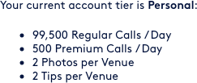
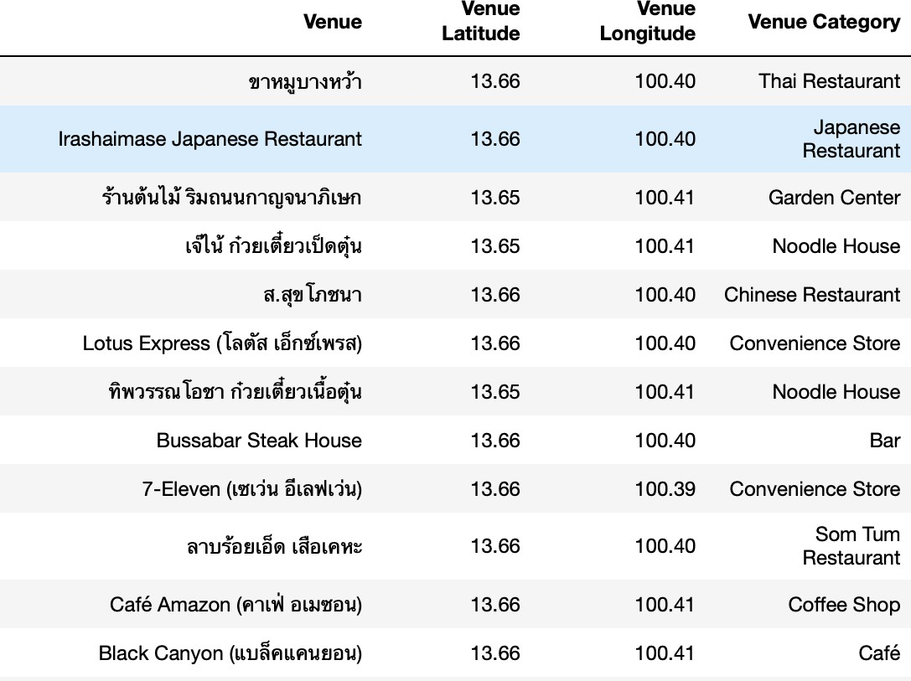
Rachata Burin 17 June 2020 IBM data science certificate Capstone project
Data Sets and APIs:
Foursquare API:
This API provides the ability to perform location search, location sharing and details about each venue. You can gather venue, tips and many useful data in easy way up to your package. In this project, I use personal package Foursquare API to get name, category and latitudes-
longitudes of nearby venues around 500 meter from interested points.
Data interface:

Slide 3
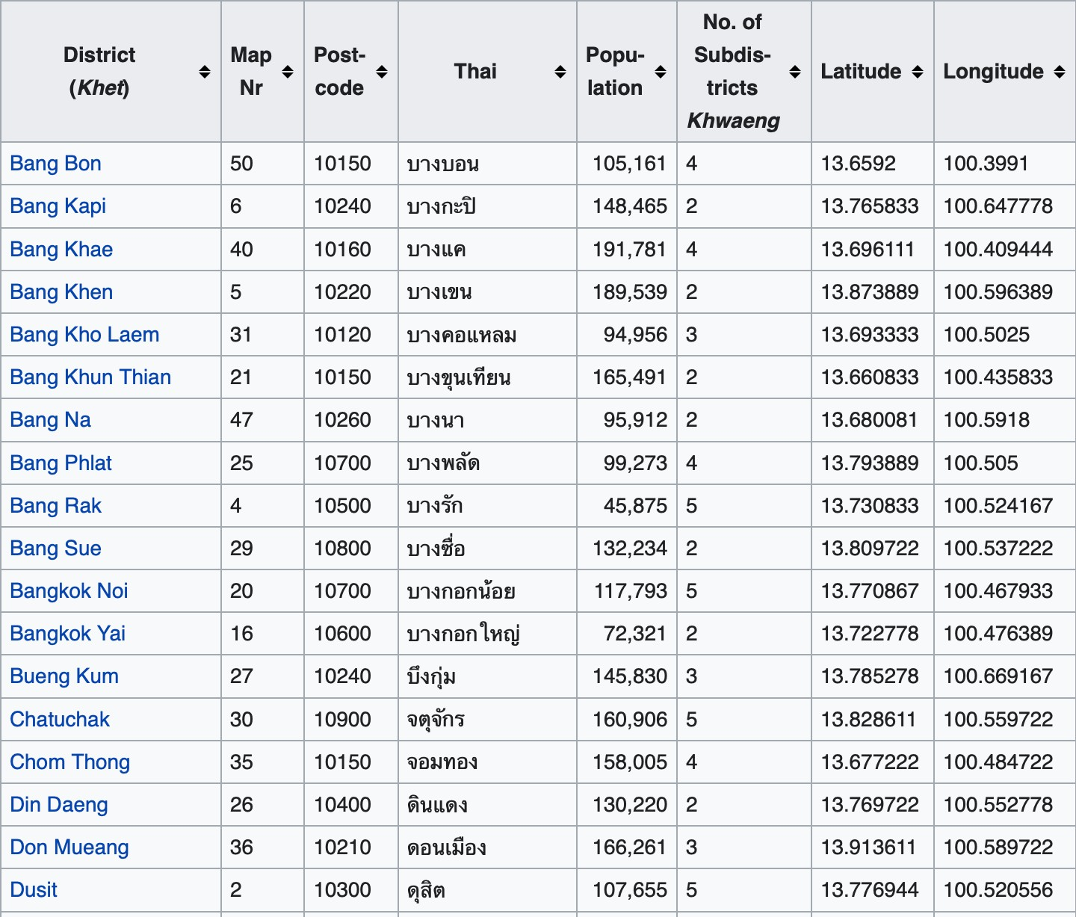
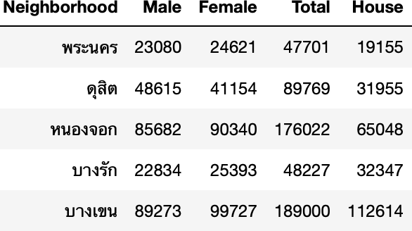
Rachata Burin 17 June 2020 IBM data science certificate Capstone project
Bangkok District Data
url : https://en.wikipedia.org/wiki/List_of_districts_of_Bangkok
I use pandas and ssl library to scrape 50 districts of Bangkok data from above url.
Raw Data
Population Data
From stat.bora.dopa.go.th
Big picture characteristics of
people who live in each district.

Slide 4
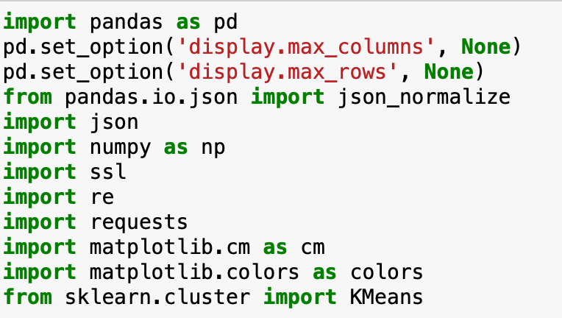
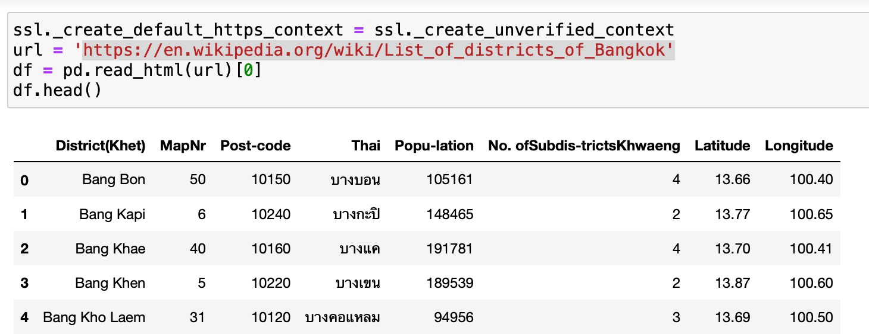
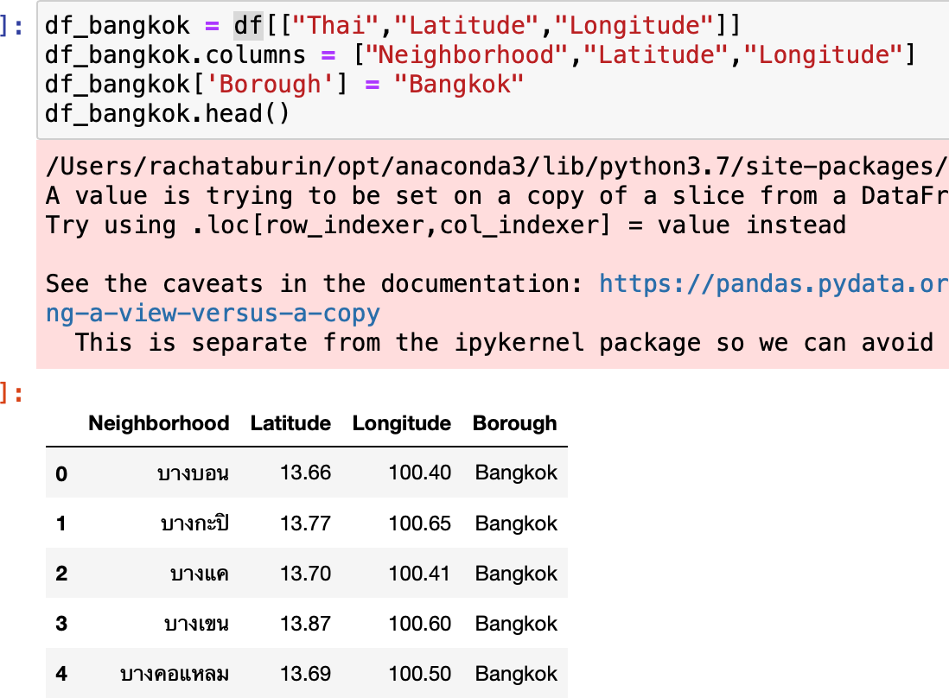
Rachata Burin 17 June 2020 IBM data science certificate Capstone project
Methodology
Start with import initial usage libraries.
Pandas : manipulate Data Numpy : mathematic operation Json. : manipulate json file type Re : manipulate string
Ssl & Requests : connect with API Matplotlib : Virtualize Data Sklearn : Model Machine learning
Scrape Bangkok districts data from Wikipedia
-Use pandas with ssl to get data
-Select useful columns ,rename them and add columns Borough.
We got 50 district in Bangkok with 4 attribute

Slide 5
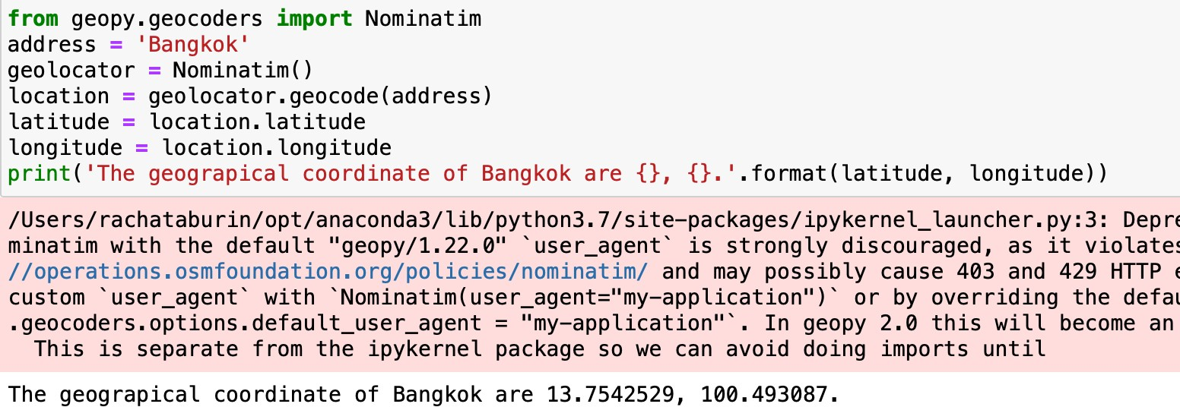
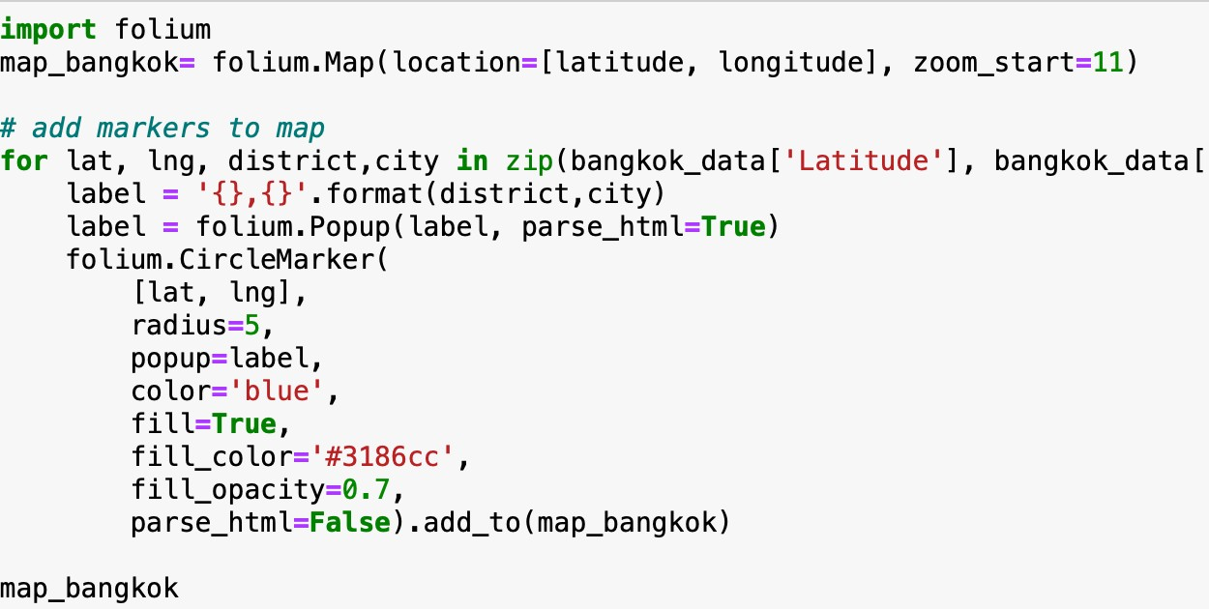
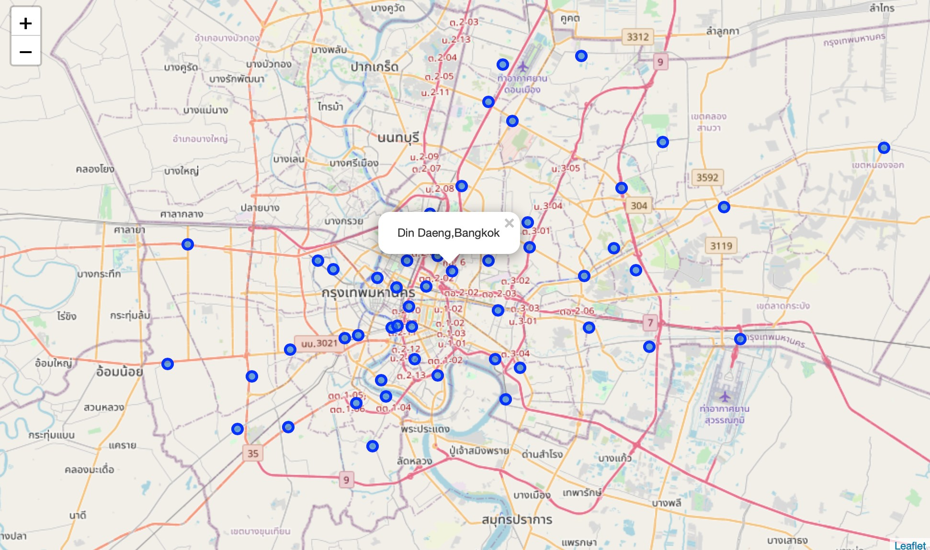
Rachata Burin 17 June 2020 IBM data science certificate Capstone project
Get latitude, longitude of Bangkok
13.7542529, 100.493087. with library geopy.
Use folium to virtualize Bangkok location with districts

Slide 6
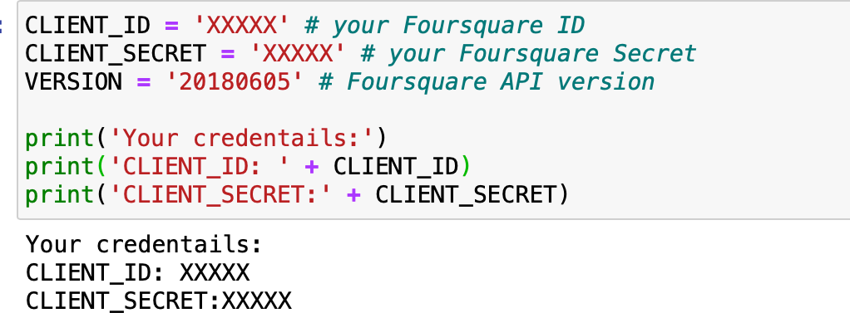
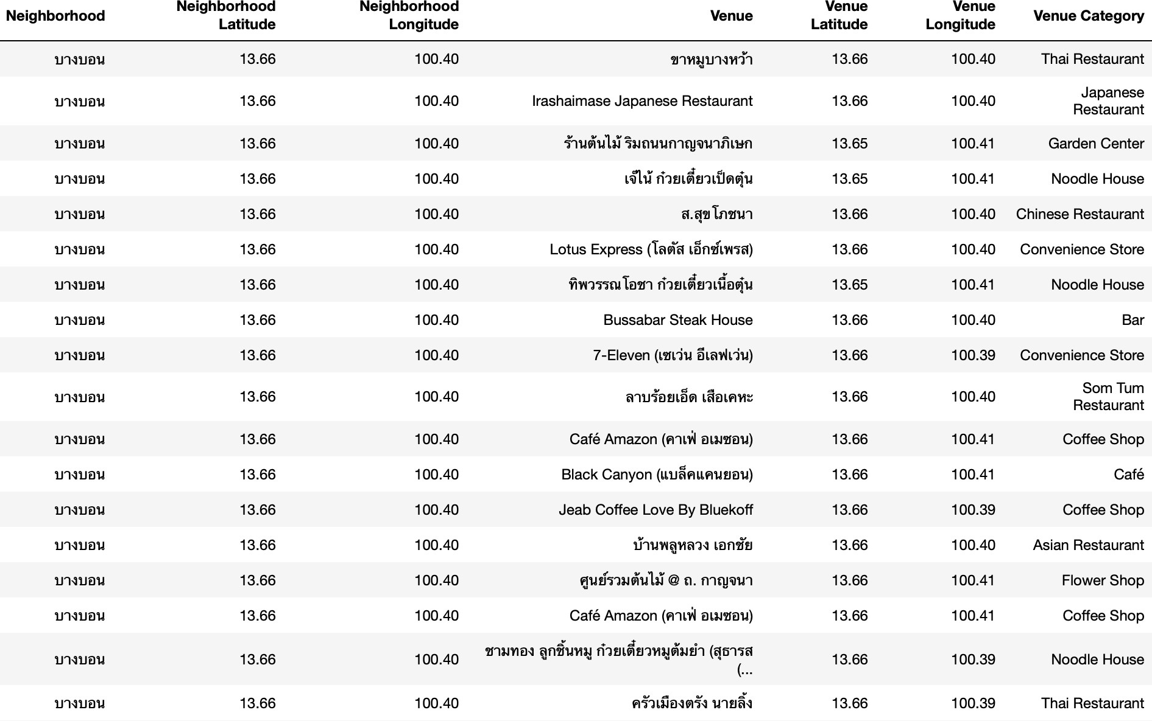
Rachata Burin 17 June 2020 IBM data science certificate Capstone project
Set up Foursquare Client
You can get this client by register Foursquare for developer account at https://developer.foursquare.com
Use Foursquare API to get nearby venue data for each districts
We get new column like Venue Category to tell which type of venue, name and latitude - longitude in 500 meter area each district coordinates.
Data shape is 2901 rows with 7 attributes
Find uniques categories type of all venue

Slide 7
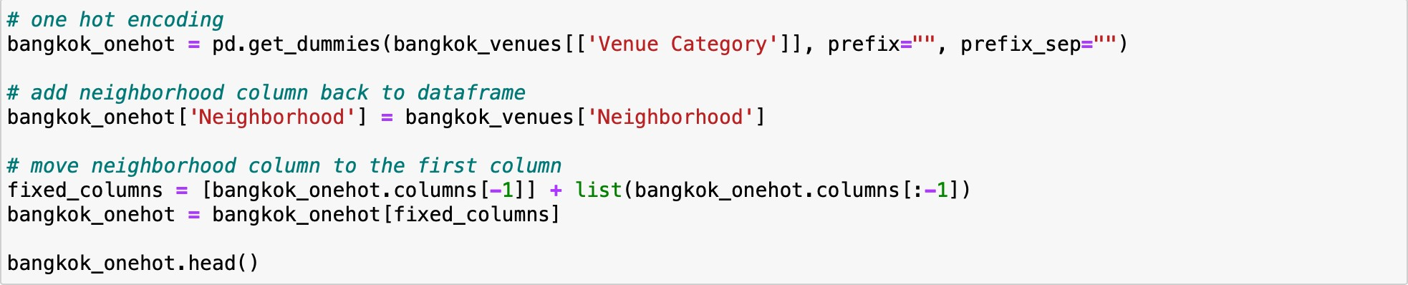
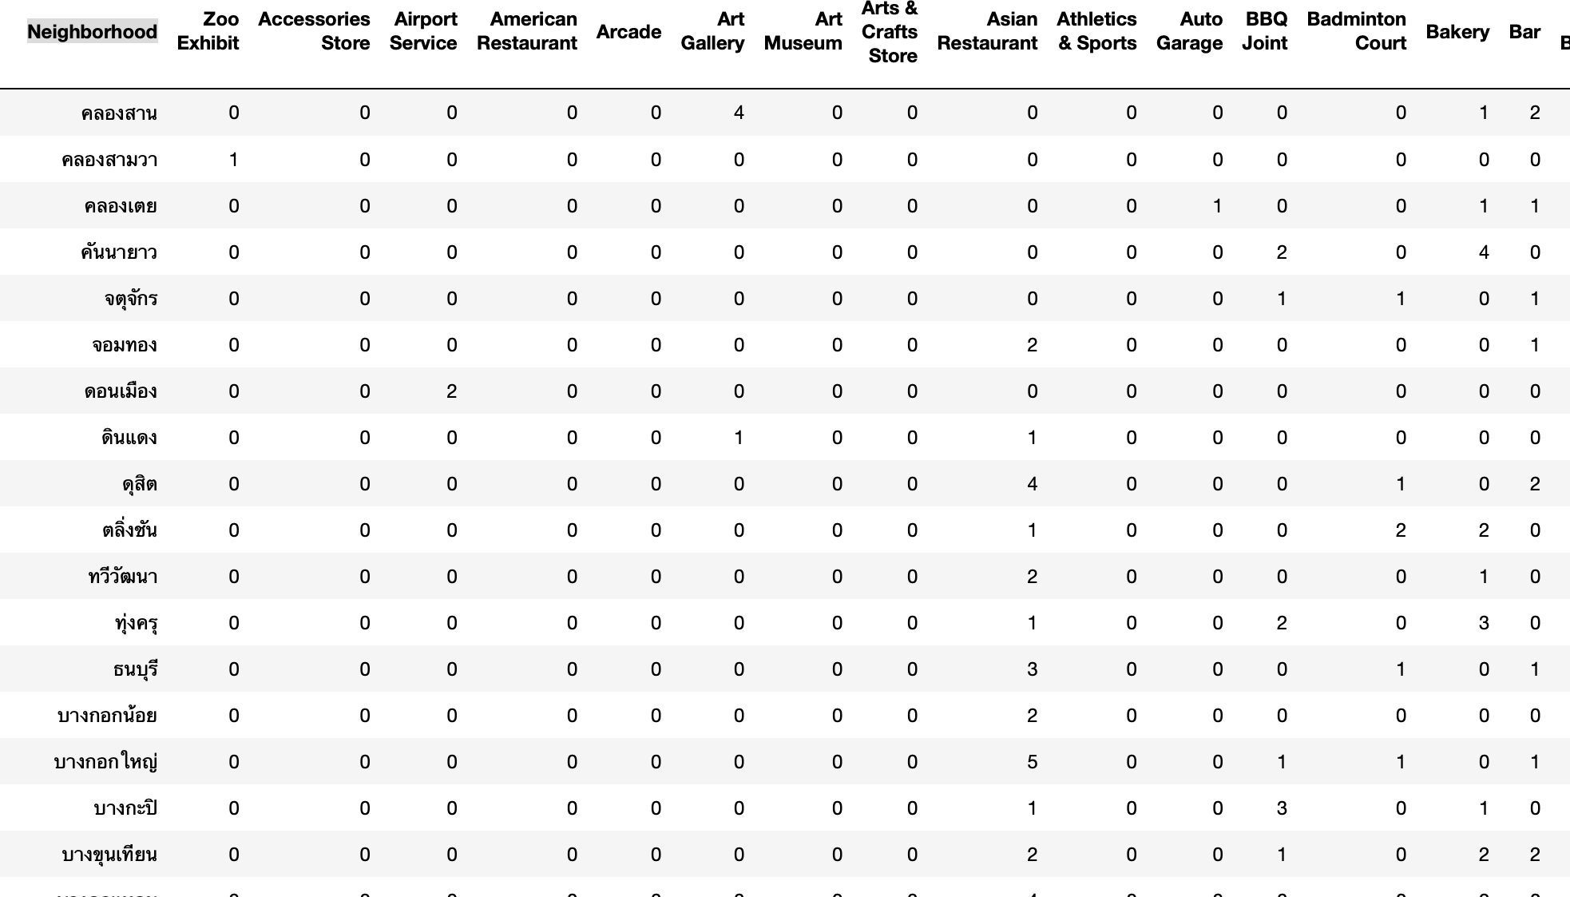
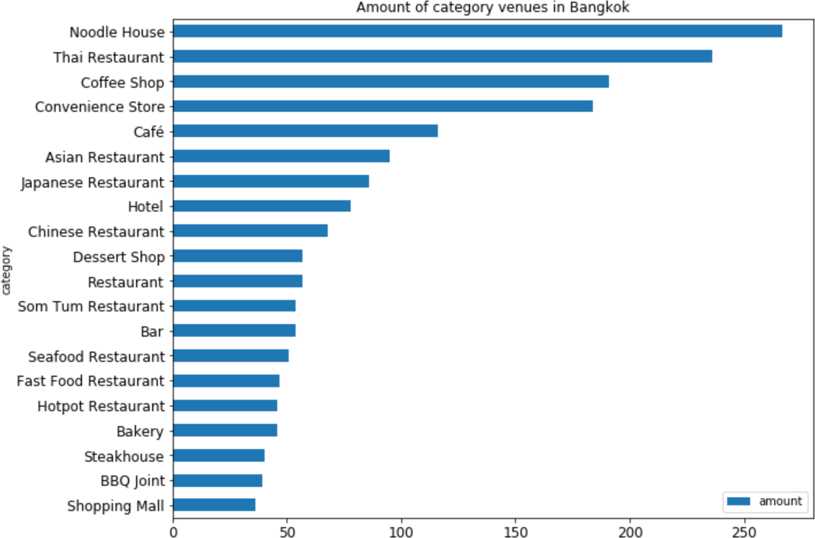
Rachata Burin 17 June 2020 IBM data science certificate Capstone project
Our data have many categories so I start to transform data in column venue category with one-hot encoder.
After group by neighborhood you will see amount for each category type in district.
Find Top 20 of venue category in Bangkok
Noodle house is 1st,
Thai restaurant is 2nd
and Coffee shop & Convenience Store is 3rd-4th

Slide 8
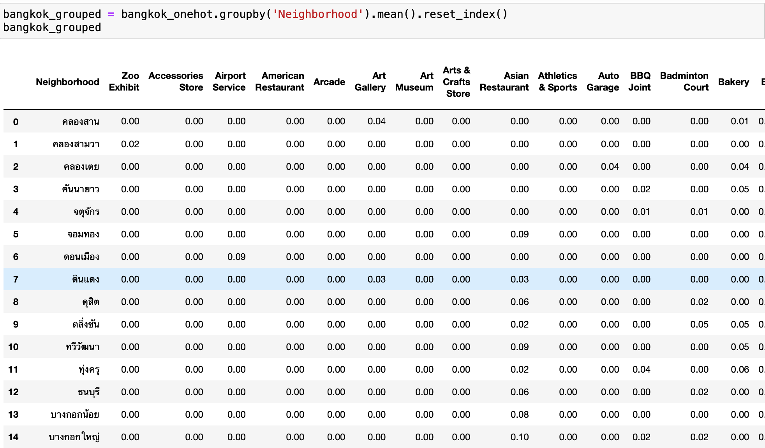
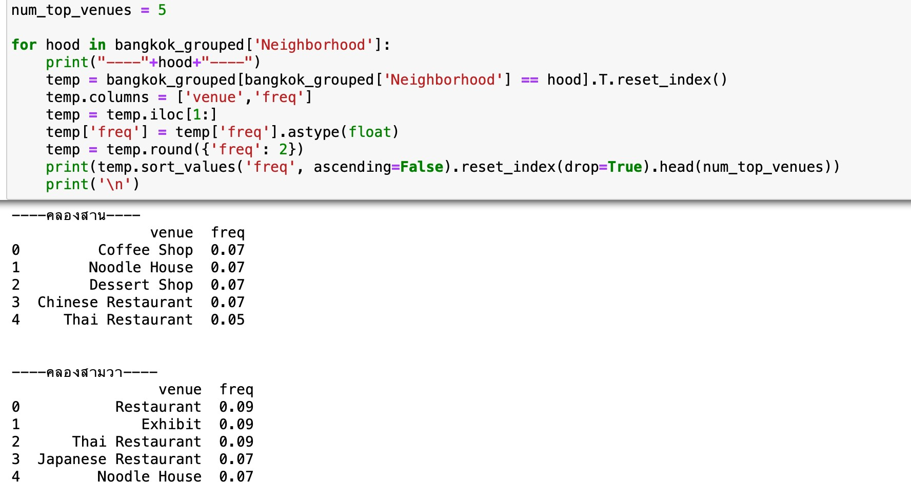
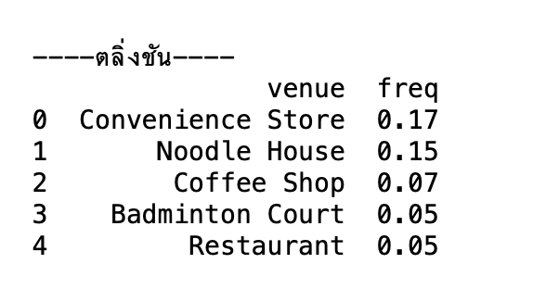
Rachata Burin 17 June 2020 IBM data science certificate Capstone project
Prepare Data for Clustering by mean amount for each category in district.
Before Clustering I want to know Top 5 venue for each district
“ตลิ่งชัน” is my own town living for 20 years but I don’t know we have Badminton Court haha.
But We have Convenience Store like 7-11 in every 1-2 km.

Slide 9
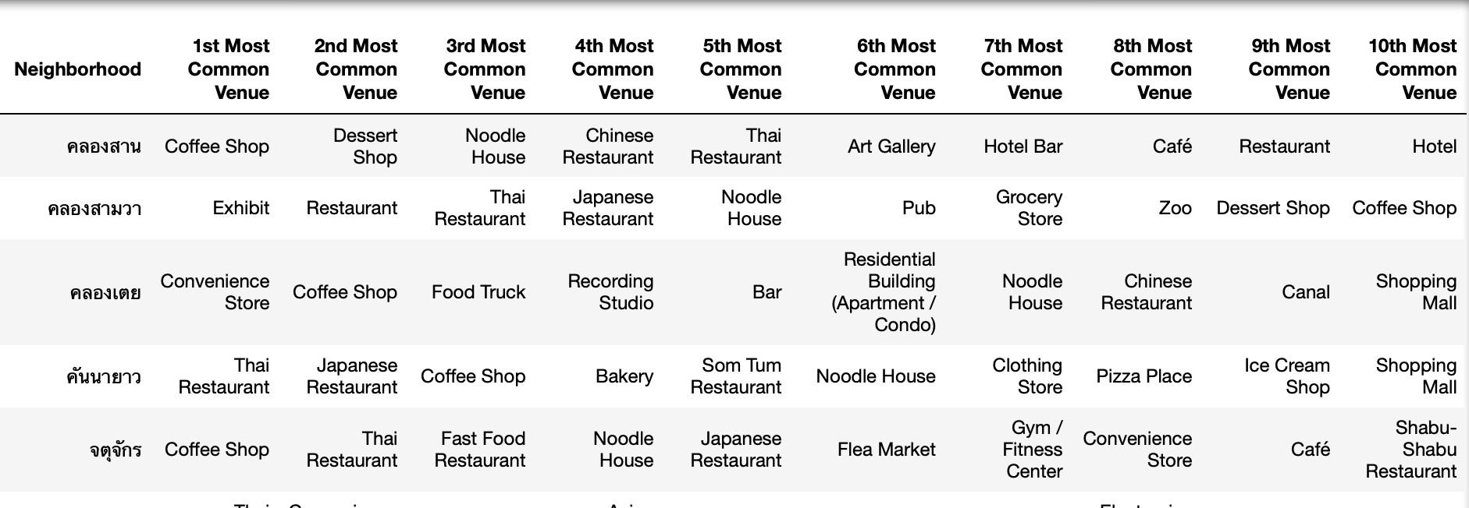
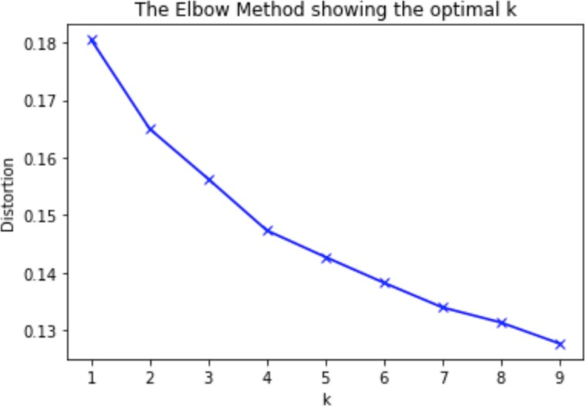
Rachata Burin 17 June 2020 IBM data science certificate Capstone project
And Generate Output to Dataframe
Use mean amount for each category in district to Clustering But I choose find number k to tell machine cluster district in k groups by Elbow Method
The Elbow method is a heuristic used in determining the number of clusters in a data set. The method consists of plotting the explained variation as a function of the number of clusters, and picking the elbow of the curve as the number of clusters
Elbow point is k =2 but It’s too less. I should next Elbow point k = 4

Slide 10
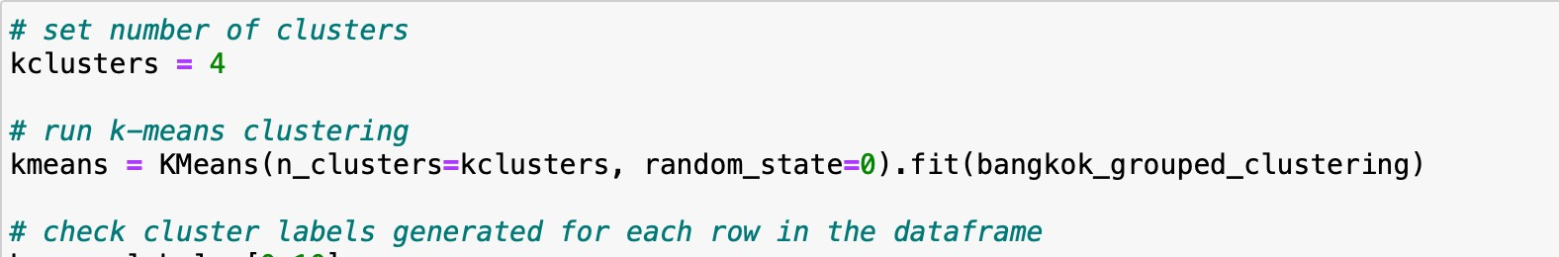
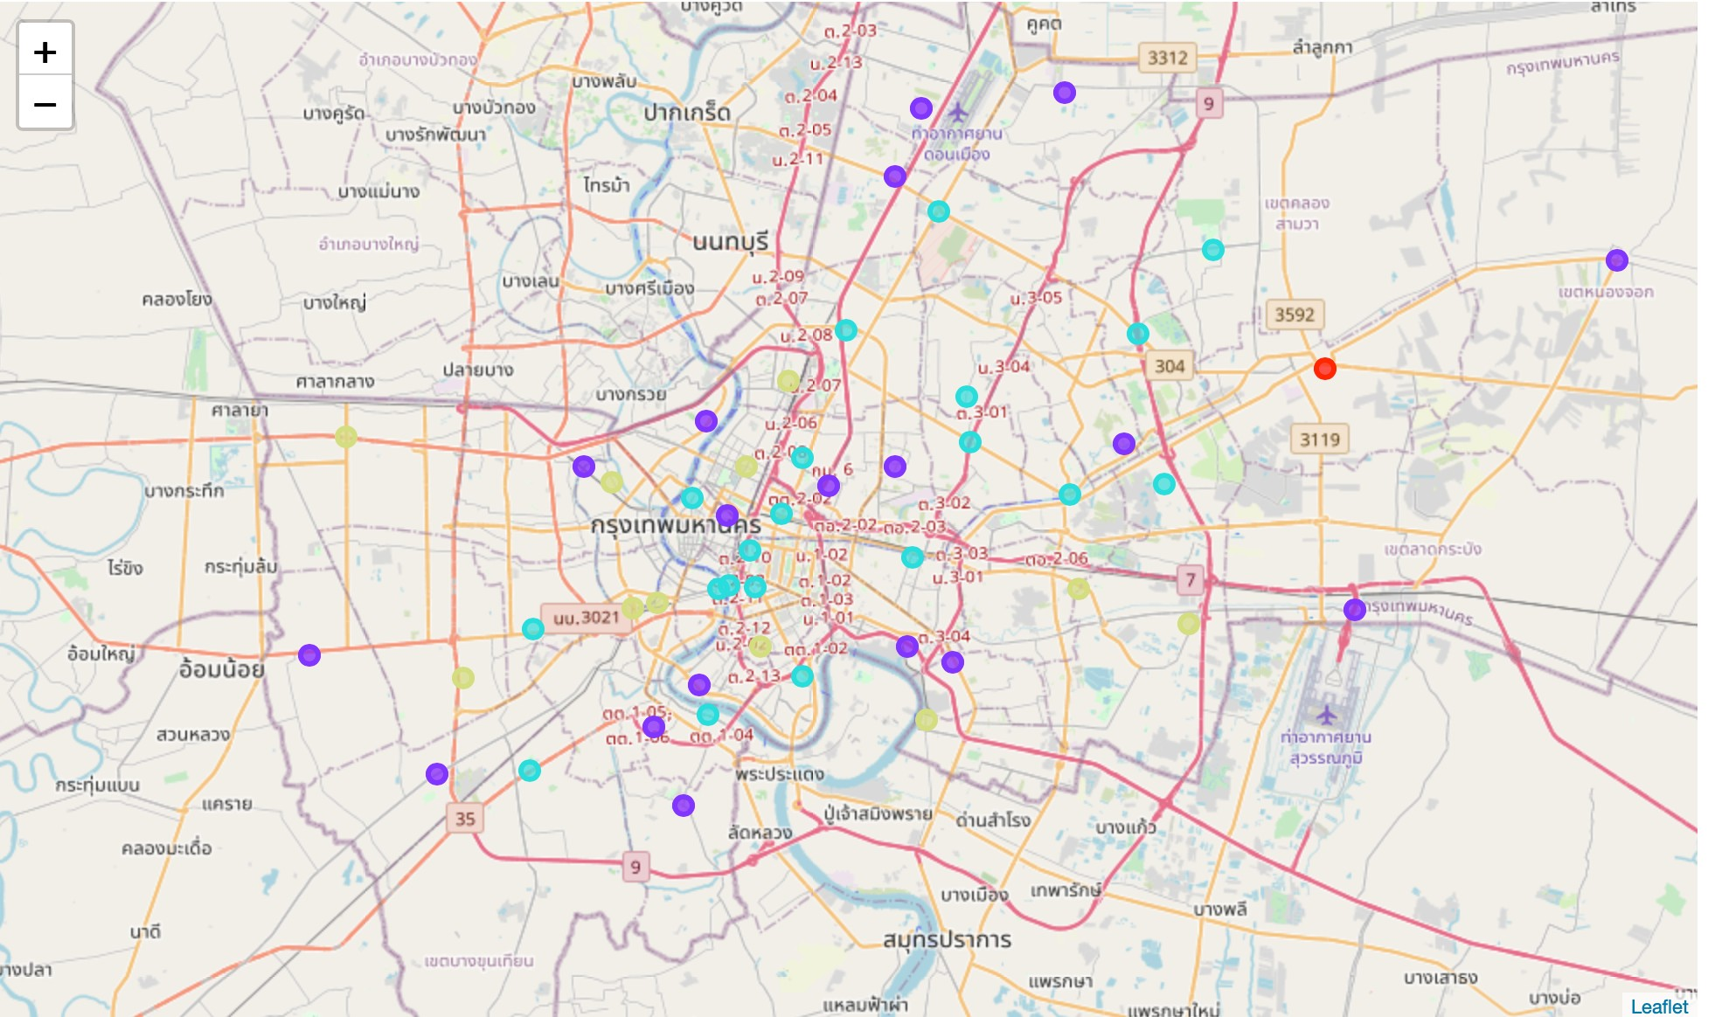
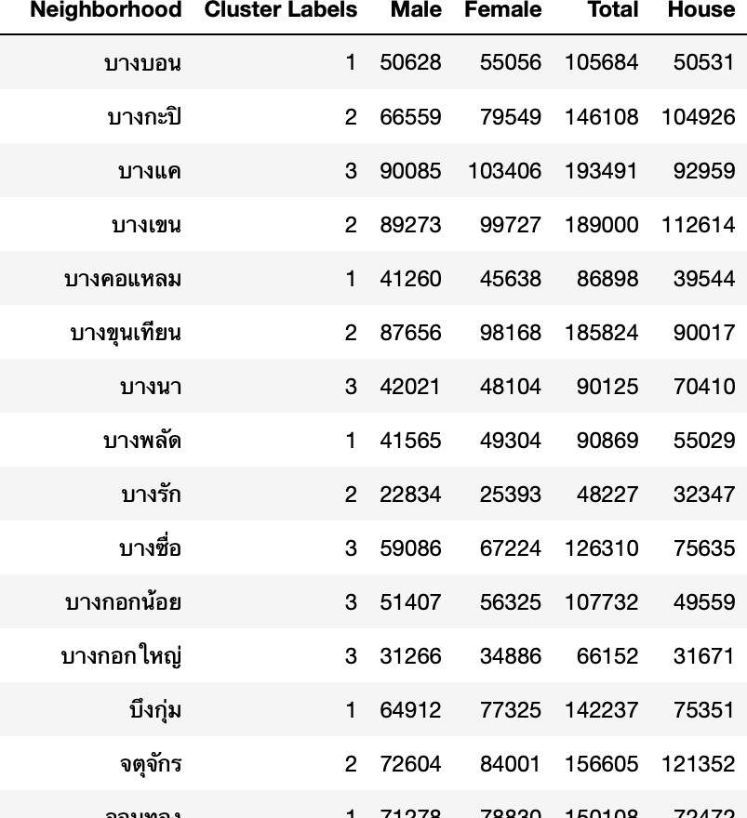
Rachata Burin 17 June 2020 IBM data science certificate Capstone project
Clustering Data by K-mean algorithm with K = 4 And you will get divided 4 group of districts
The Last, Find and explore description for each clusters you will get information like
What top category for each cluster/ district?
What is each cluster?
How many people in each cluster and what kind of them male or female?
Find solution strategy to decision to open new business

Slide 11
Rachata Burin 17 June 2020 IBM data science certificate Capstone project
Result
Tops 20 of venue category in Bangkok
Noodle house is 1st,
Thai restaurant is 2nd
Coffee shop & Convenience Store is 3rd-4th

Slide 12
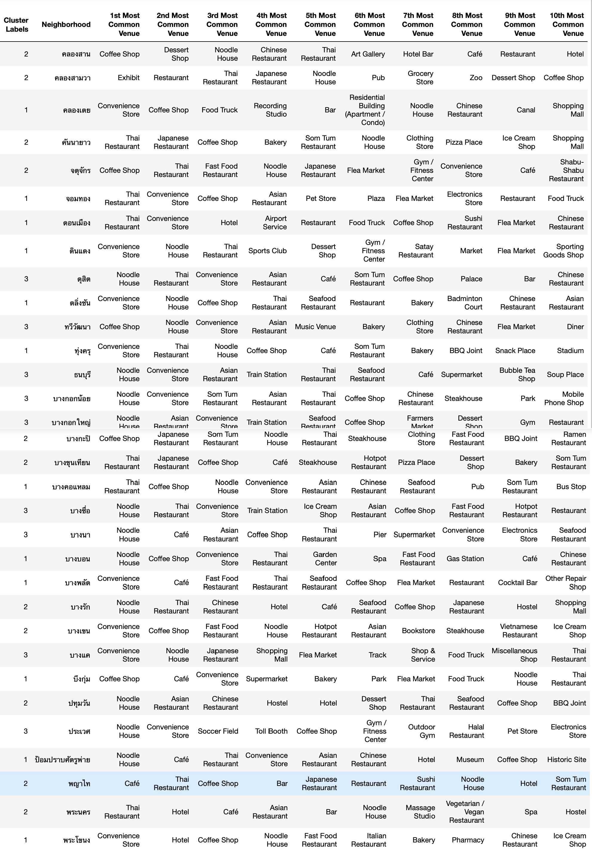
Rachata Burin 17 June 2020 IBM data science certificate Capstone project
Tops 10 category and cluster group for each district in Bangkok

Slide 13
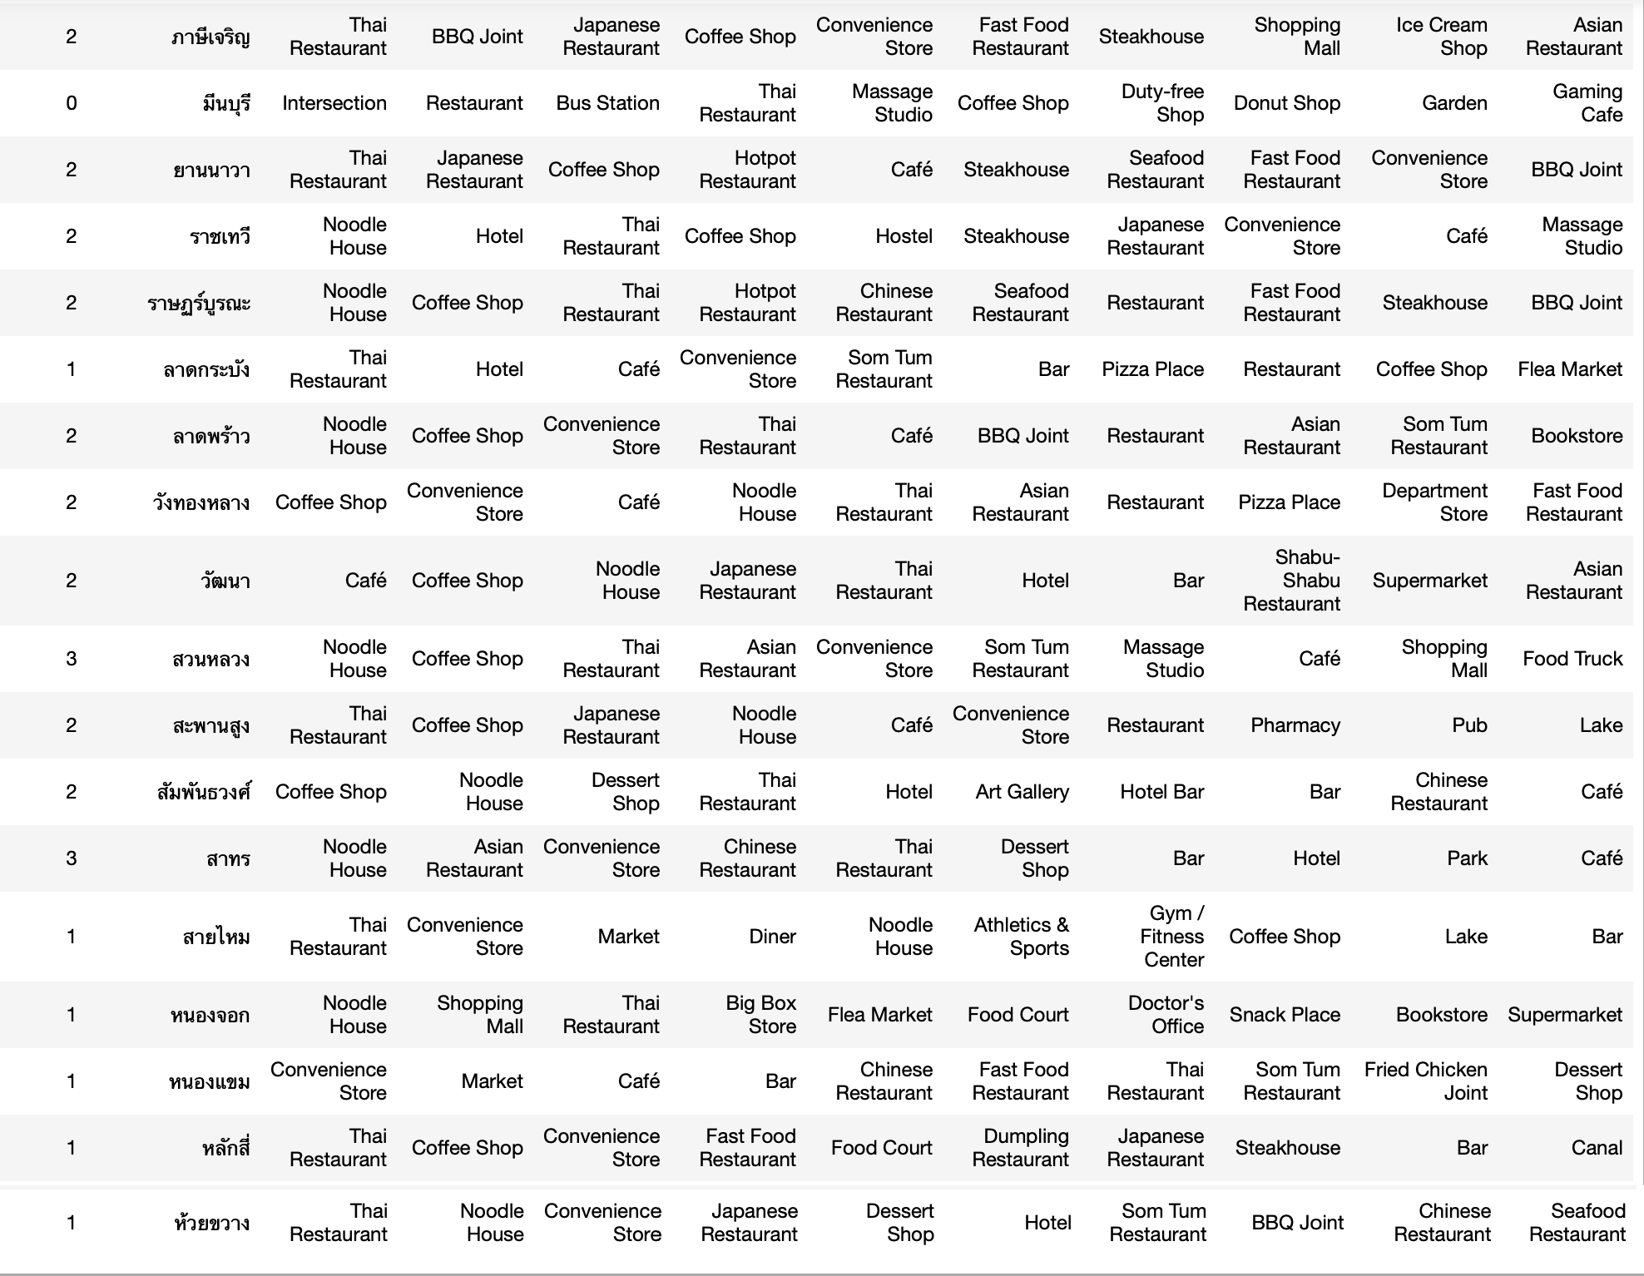
Rachata Burin 17 June 2020 IBM data science certificate Capstone project

Slide 14
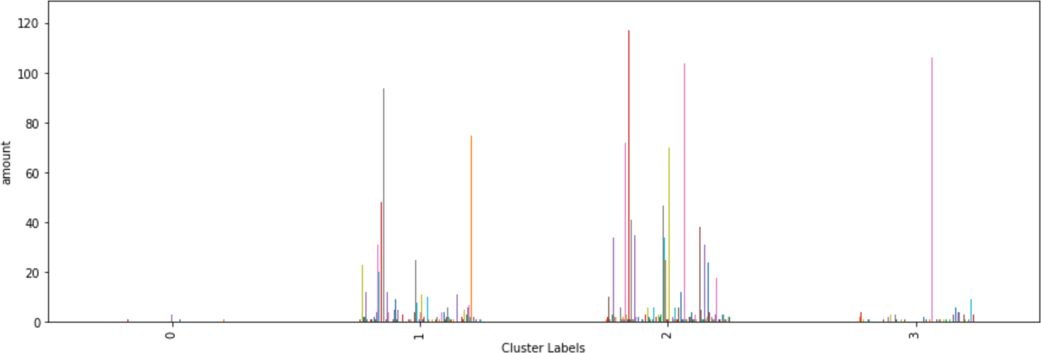
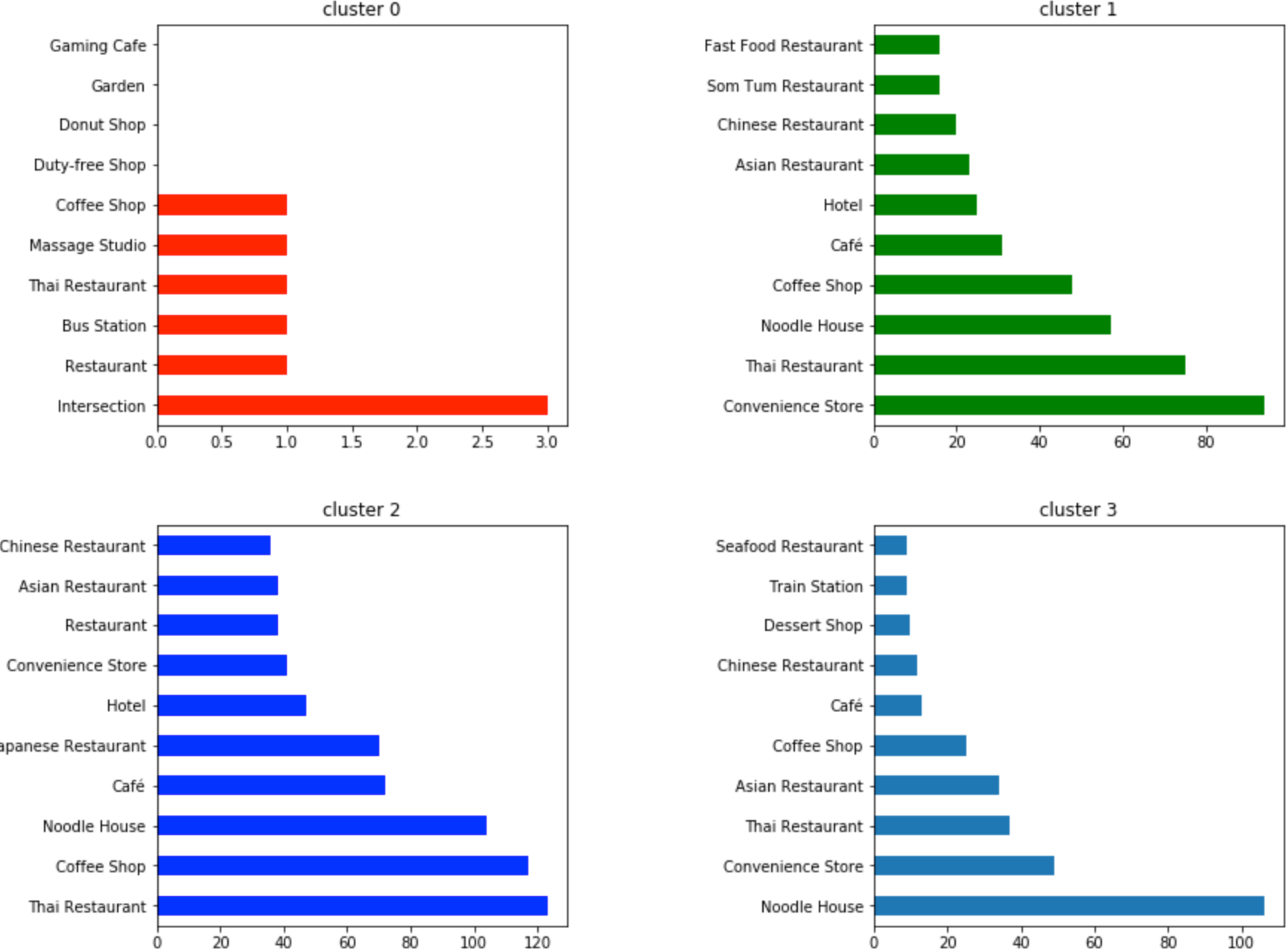
Rachata Burin 17 June 2020 IBM data science certificate Capstone project
What is each clusters?

Slide 15
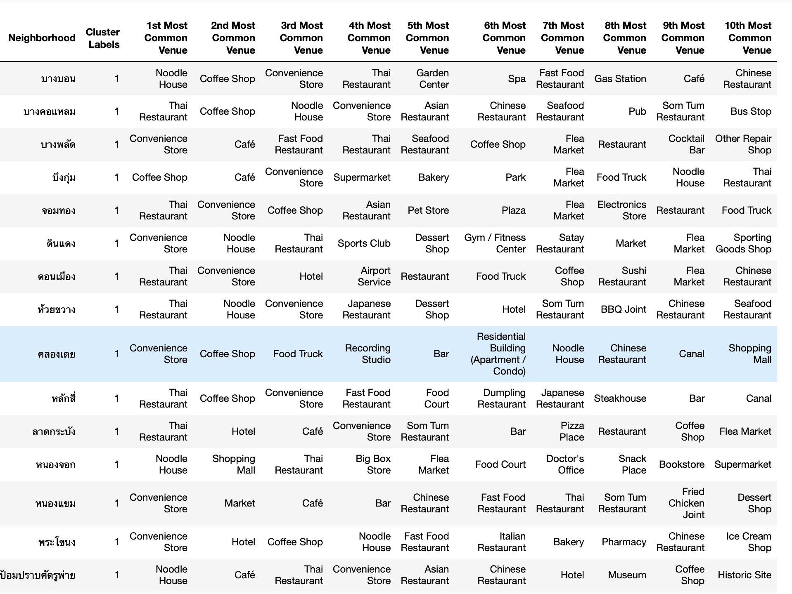
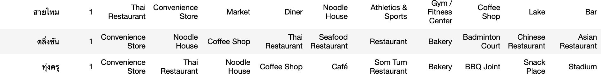
Rachata Burin 17 June 2020 IBM data science certificate Capstone project
Cluster 0 : Group of District which have main Intersection venue
Cluster 1 : Group of District which have main Convenience Store venue

Slide 16
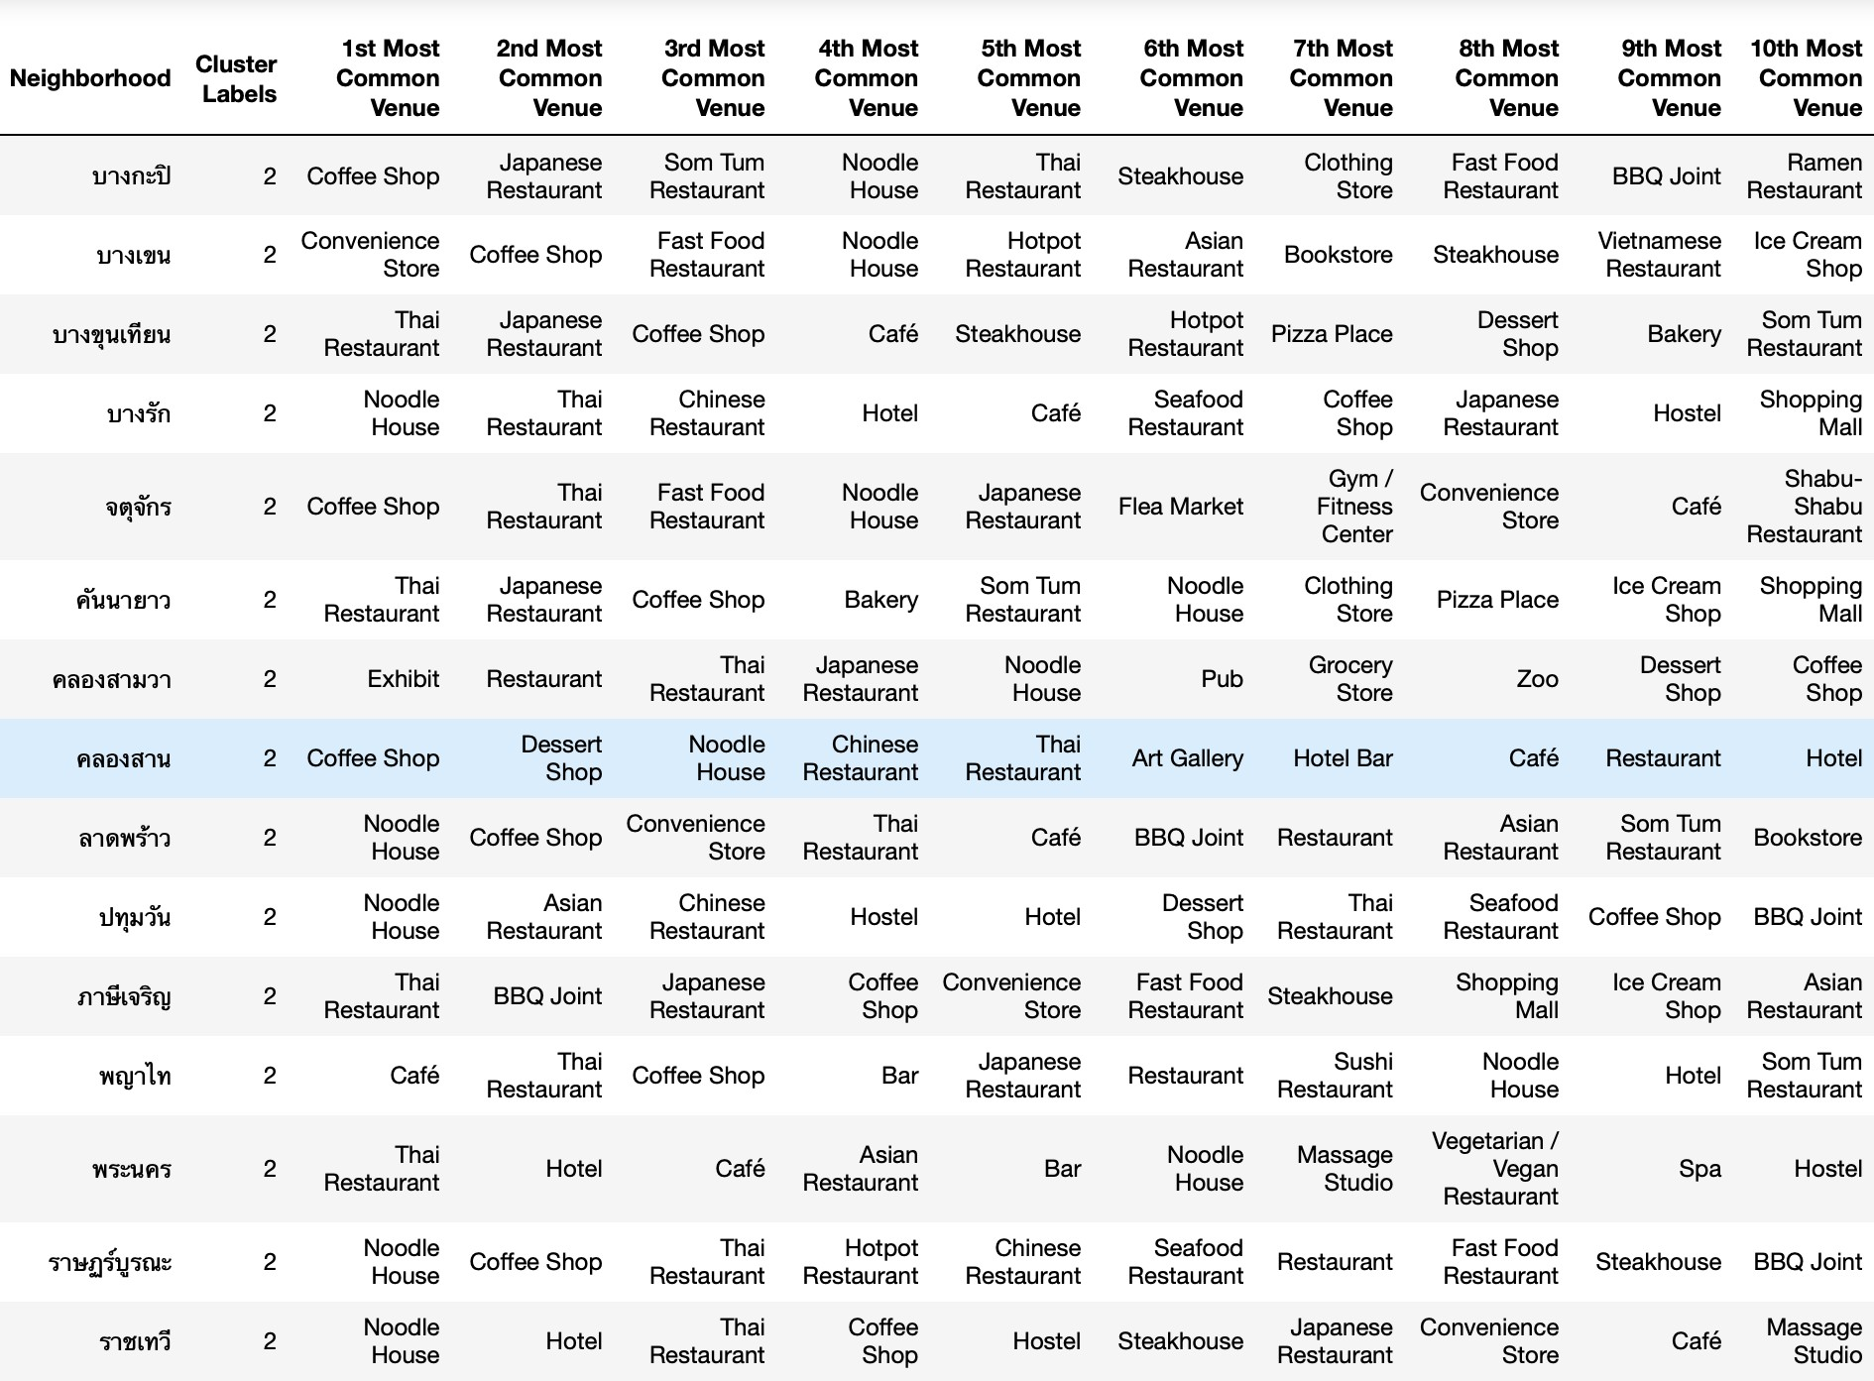
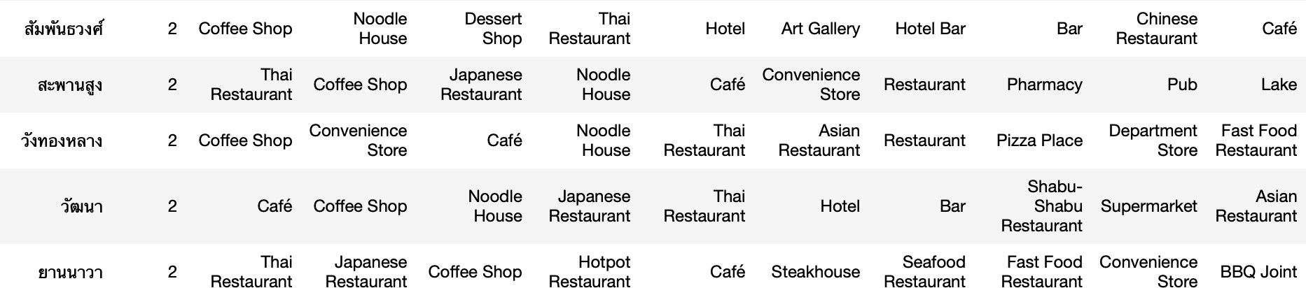
Rachata Burin 17 June 2020 IBM data science certificate Capstone project
Cluster 2 : Group of District which have main Coffee Shop and Cafe venue

Slide 17
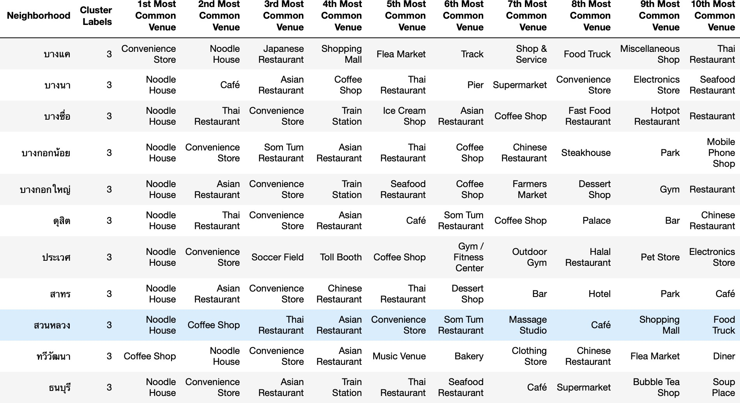
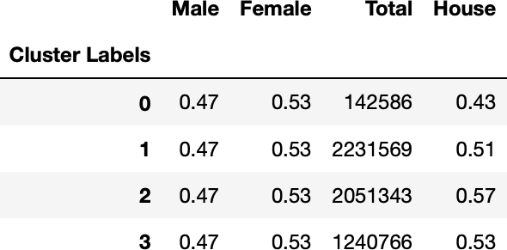
Rachata Burin 17 June 2020 IBM data science certificate Capstone project
Cluster 3 : Group of District which have main Noodle House venue
Population for each cluster
This data tells we have female more than male in every cluster around 6% and show amount of people in each cluster

Slide 18
Rachata Burin 17 June 2020 IBM data science certificate Capstone project
Discussions
My result is depend on area around coordinate input from Foursquare API .It doesn’t have all venue in each district but only around 500 meter from coordinate input.And my analysis is not predictive or regression model but use to support in decision. I can’t vonclude that you show open this in that place or in that district
But I want you to see overall picture what almost people open in each districts to be guide line for you to create business model for your own.
Conclusion
From our result, I know top venue categories and district clusters area in Bangkok after that I want to know, if I'm a new contractor is trying to start my own business, Which venue categories and district clusters area should I open?
I have many ways to decide which venue category I should open.
For about Category
If I have no choise in mind,
I can start with top category like Noodle House,Thai Restaurant,Coffee Shop or Convenience Store. On the other hand,
I can start with non-popular category like Hainan Restaurant,Gaming Cafe or Organic Grocery.
For about District
If I decide to open Noodle house,I have many way to decide too.
I can open at cluster labels number 3 which has the most amount of Noodle house venues in Bangkok.
I can open at some district in other cluster which hasn't many Noodle house venue like สายไหม,บางพลัด or มีนบุรี.
I can open at some district which my venue have influence.Example, I know in cluster 2 most popular categories are cafe and coffee shop so I can open import coffee beans shop in this cluster.
For about Population
In every clusters in Bangkok have female more than male around 6%, so It will be useful for female's product.

